Slide 1
Learning for Life Quiz

Slide 2
B1 Student’s Book related questions

Slide 3
How often do people touch their smartphone per day?
A
2,617 times
B
1,511 times
C
864 times
D
168 times

Slide 4
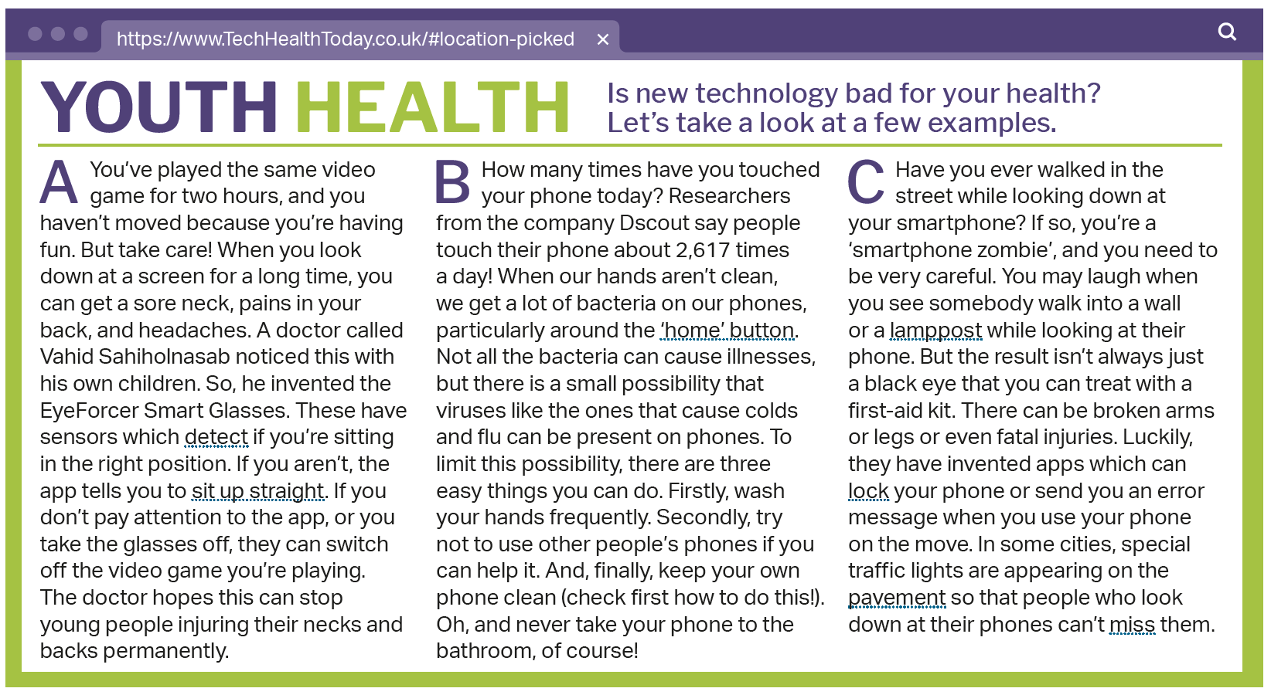
Insert screenshot page 45 B1 SB
Studentbook B1, page 45

Slide 5
How often do people touch their smartphone per day?
A
2,617 times
B
1,511 times
C
864 times
D
168 times

Slide 6
How much will the global sea level rise between now and 2100?
A
between 2 and 20 cm
A
B
between 20 and 200 cm
C
between 1 and 10 cm
D
between 10 and 100 cm

Slide 7
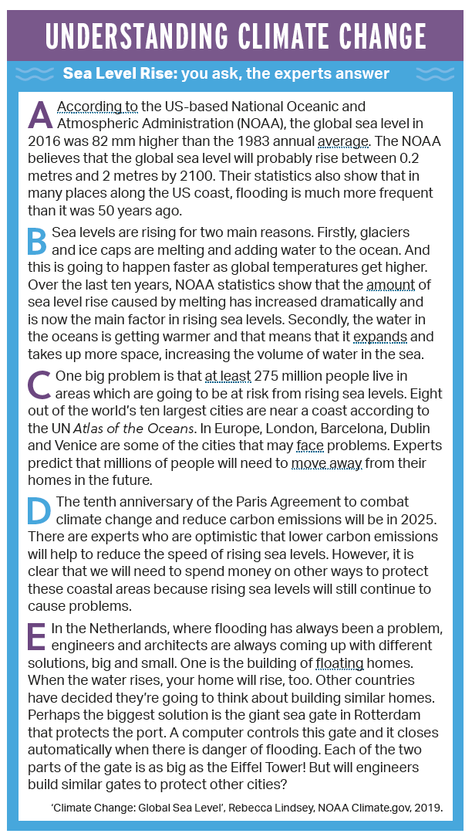
Studentbook B1, page 71

Slide 8
How much will the global sea level rise between now and 2100?
A
between 2 and 20 cm
B
between 20 and 200 cm
C
between 1 and 10 cm
D
between 10 and 100 cm

Slide 9
How long does it take for plastic straws to break down into tiny pieces?
A
up to 4.5 years
B
Up to 37 years
C
Up to 121 years
D
Up to 200 years

Slide 10
Insert screenshot page 75 B2 SB NOPE
Studentbook B1, page 75

Slide 11
How long does it take for plastic straws to break down into tiny pieces?
A
up to 4.5 years
B
Up to 37 years
C
Up to 121 years
D
Up to 200 years

Slide 12
B1+ Student’s Book related questions

Slide 13
How many litres of water does it take to create one T-shirt?
A
534 litres
B
967 litres
C
1,689 litres
D
2,727 litres

Slide 14
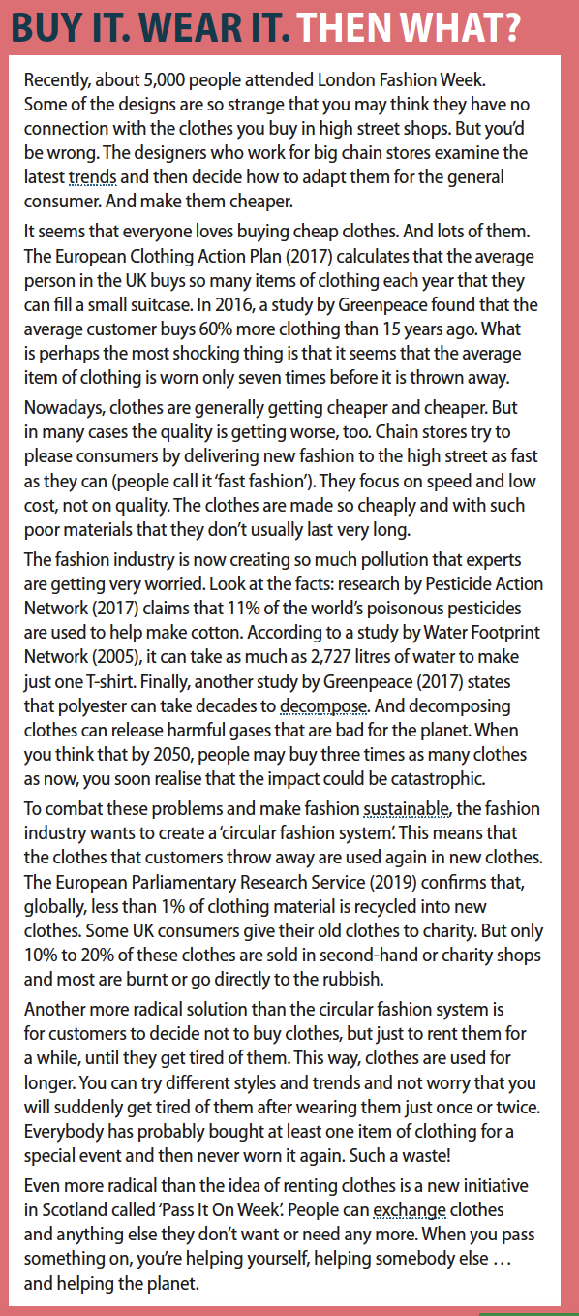
Studentbook B1+, page 123

Slide 15
How many litres of water does it take to create one T-shirt?
A
534 litres
B
967 litres
C
1,689 litres
D
2,727 litres

Slide 16
In the UK, out of every 5 bags of food bought, how many get thrown away?
A
1 bag
B
2 bags
C
3 bags
D
4 bags

Slide 17
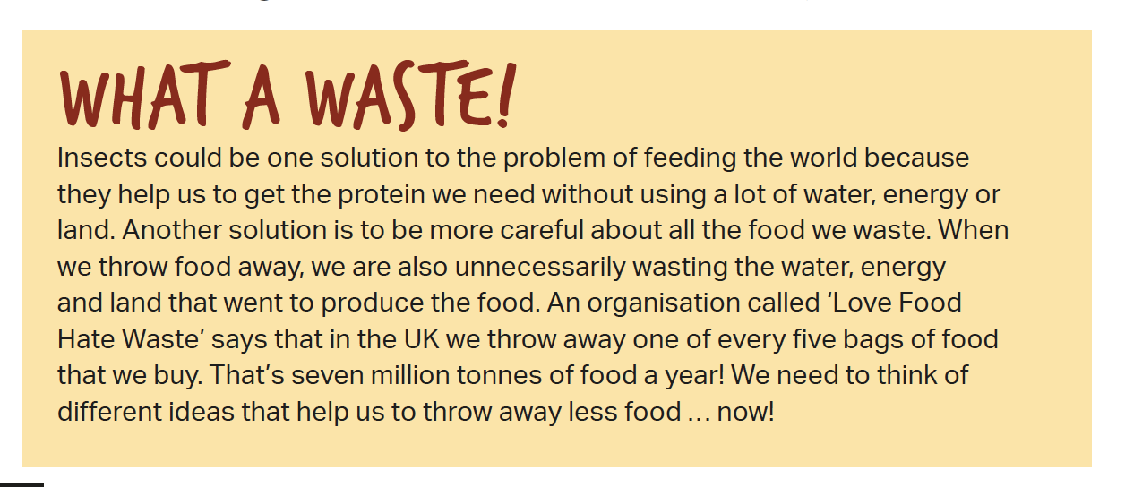
Studentbook B1+, page 48

Slide 18
In the UK, out of every 5 bags of food bought, how many get thrown away?
A
1 bag
B
2 bags
C
3 bags
D
4 bags

Slide 19
How many people around the world do not have easy access to electricity?
A
500,000,000 500,000,000
500,000,000
30,000,000 people
B
500,000,000 people
C
1,000,000,000 people
2,500,000,000 people
D

Slide 20
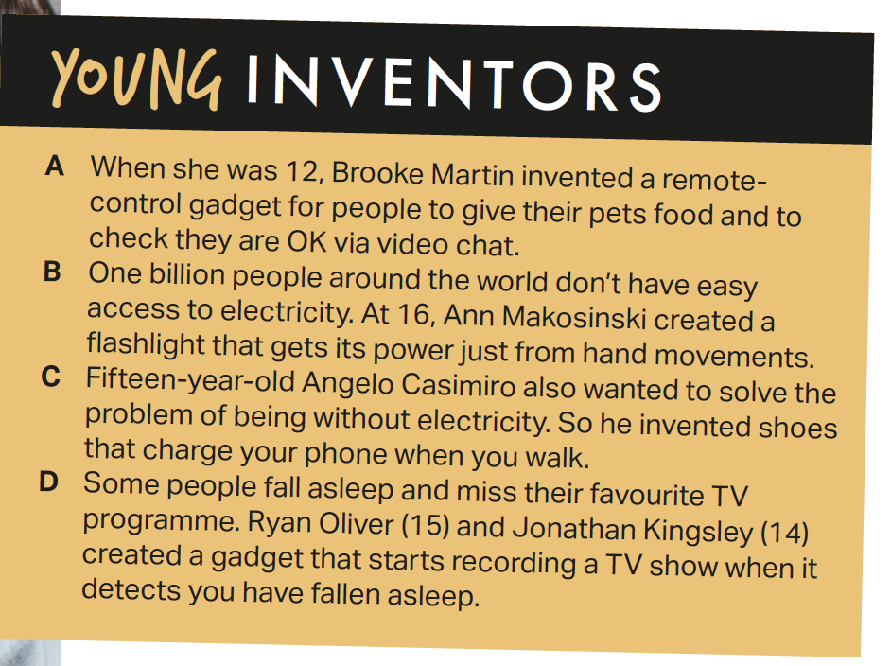
Studentbook B1+, page 75

Slide 21
How many people around the world do not have easy access to electricity?
A
500,000,000 500,000,000
500,000,000
30,000,000 people
B
500,000,000 people
C
1,000,000,000 people
2,500,000,000 people
D

Slide 22
B2 Student’s Book related questions

Slide 23
What is the expected world population in 2050?
A
500,000,000 500,000,000
500,000,000
8 billion
B
10 billion
C
12 billion
14 billion
D
Notes:
Start wih elicitng what is is now.. About 7

Slide 24
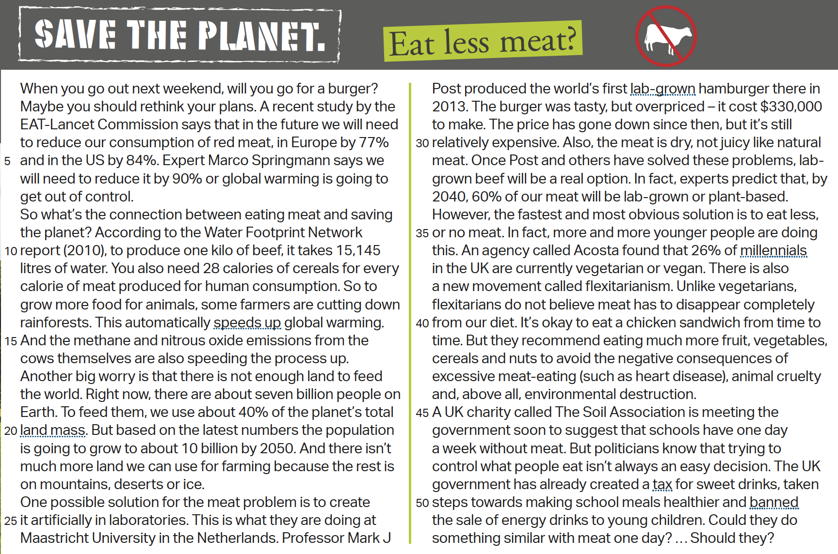
Studentbook B2, page 59

Slide 25
What is the expected world population in 2050?
A
500,000,000 500,000,000
500,000,000
8 billion
B
10 billion
C
12 billion
14 billion
D
Notes:
Start wih elicitng what is is now.. About 7

Slide 26
What percentage of purchases made in Sweden are cashless?
A
30%
B
50%
C
65%
D
80%

Slide 27
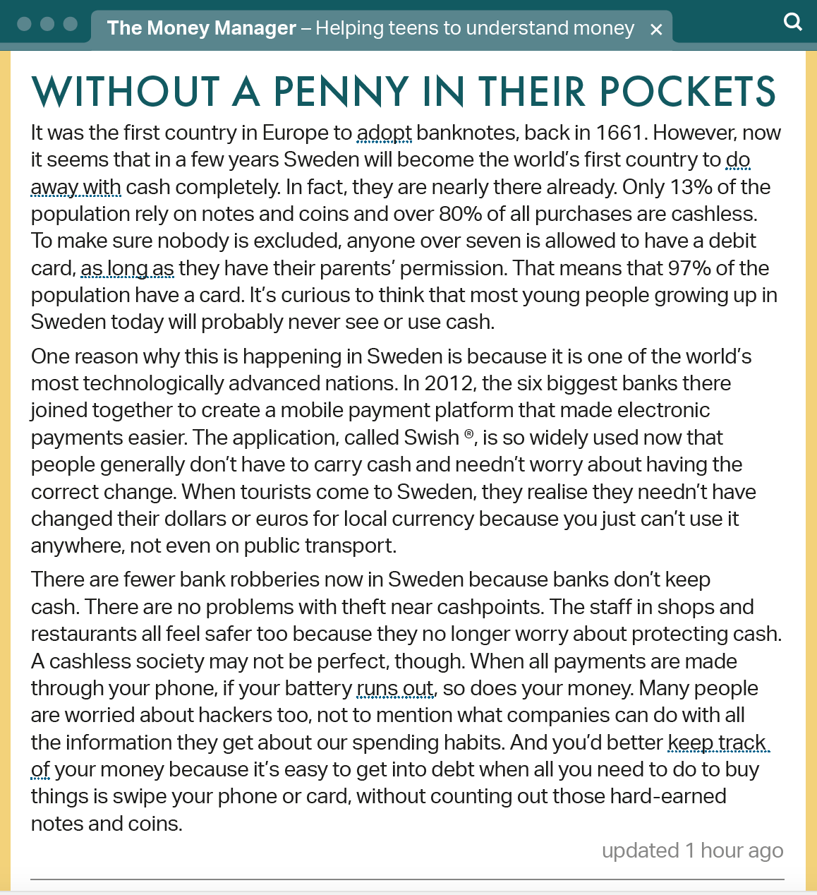
Studentbook B2, page 59

Slide 28
What percentage of purchases made in Sweden are cashless?
A
30%
B
50%
C
65%
D
80%

Slide 29
How much water does it take to produce a kilo of beef?
A
86 litres
B
645 litres
C
8,934 litres
D
15,145 litres

Slide 30
Studentbook B2, page 59

Slide 31
How much water does it take to produce a kilo of beef?
A
86 litres
B
645 litres
C
8,934 litres
D
15,145 litres

Slide 32
Follow Dave Spencer at facebook.com/teachwithdave
Follow Macmillan English at facebook.com/macmillaneducation

